Slide 1
How a Five-Hour-a-Week Side Project Crossed Silos and Saved IT Service Operators
2024/7/10
Susumu Tomita
Naomichi Shimazu
Notes:
Hello now we introduce "How a Five-Hour-a-Week Side Project Crossed Silos and Saved IT Service Operators"

Slide 2
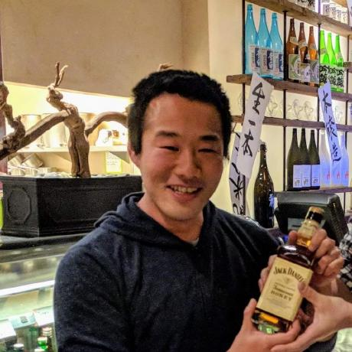
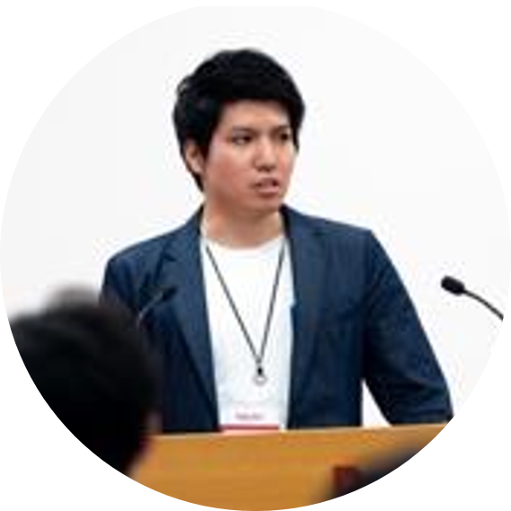

Self Introduction
Susumu Tomita
Department: CCoE Section, Digital Innovation Department, Cloud Services R&D Division
Role: Software Engineer
About: I joined DENSO CORP.(DENSO) in 2018. My current role involves software development for web services and working within the CCoE. I focus on creating software solutions that support our cloud services.
Naomichi Shimazu
Department: CCoE Section, Digital Innovation Department, Cloud Services R&D Division
Role: Software Engineer
About: I joined DENSO in 2017. Architectural design and construction of web services.
Outside of work, I enjoy making and eating sushi!
Notes:
"Let's introduce ourselves. I'm Susumu Tomita. I am also a software engineer in the Cloud Services R&D Division, and I work in the CCoE Team. I joined DENSO in 2018. My role focuses on developing software for our web services and contributing to our Center of Excellence for Cloud.
Next, I'm Naomichi Shimazu. I work with the Cloud Services R&D Division at DENSO, specifically in the CCoE Team. I joined DENSO in 2017. My job involves designing and building web services, and I also define the technical requirements that these services need to meet. When I'm not working, I enjoy making and eating sushi—it's one of my favorite hobbies!

Slide 3

About DENSO: Embracing Cloud Technology
Tech Changes:
  DENSO is leader in changing car technology. Cars are now more using computer technology
  for Software-Defined Vehicles , connected cars and so on.
Need for New Skills:
  Many embedded software engineers are working in DENSO, but we need expand our capability more.
  For example cloud and web technologies.
What We Do:
  Design and implement the next generation cars. Safer, easy to use and integrated Cloud and new technologies..
Denmaru
Notes:
DENSO is a manufacturing company.
The web and cloud software domain is a challenge for us.
At DENSO, we see big changes in how we make cars. Cars today need to work like smart devices and use lots of new technology.
We have always been good at creating software for cars.
But now, we need to combine this with cloud and web technologies.
This means we need new skills.
Right now, DENSO has few cloud engineers.
Therefore, many projects rely on external contractors.
Some teams only have one or two DENSO employees who are cloud engineers.
This puts a lot of cloud-related work on these few people.
DENSO is looking for software engineers who are passionate about making cars smarter.
There are exciting opportunities to improve how cars connect, make them safer, and develop self-driving cars.
DENSO needs people who are excited about using new technologies to make cars better.

Slide 4
Cloud Services R&D Division
Division Launch:
  Our department established in 2017 to enhance our capabilities in cloud technologies.
Diverse Team Composition:
  Our team includes not only software engineers but also business developers, combining technical
  and commercial expertise.
Collaborative Approach:
  Our business and development teams work together closely, using a 'try and error' method to rapidly develop and refine software products.
Growth Strategy:
  We start our projects small and scale them up gradually based on success and learning.
Notes:
In 2017, DENSO started the Cloud Services R&D Division.
This division uses cloud technology to make our products and services better.
The team is a bit unique because it has different types of experts.
We have software engineers and business experts working side by side.
Working together is important.
Business experts and developers use trial and error to create, test, and improve software quickly.
This fast process helps us keep up with new technology. We start projects small to manage risks and learn.
When our ideas and strategies work, we make the projects bigger and more impactful.

Slide 5
Technology stacks
AWS
  As the backbone of our cloud infrastructure, AWS provides us with the flexibility
  and scalability necessary for our demanding applications.
Terraform
  We use Terraform extensively for infrastructure as code, which allows us to manage
  our cloud resources efficiently and reliably.
Ruby on Rails
  While Ruby on Rails is our primary development framework, we are open to integrating other technologies as needed.
GitHub
  For continuous integration and deployment, we use GitHub Actions to automate our software delivery process.
Notes:
Here’s DENSO's Cloud Services R&D Division major technology stacks.
AWS: We use AWS for its strong cloud infrastructure.
It gives us the scalability and flexibility we need for our projects.
Terraform: Terraform lets us define and manage our cloud infrastructure with code.
This helps us keep things consistent and deploy new services quickly.
Ruby on Rails: Ruby on Rails is our main framework for building applications.
We also use other technologies as needed.
GitHub: We use GitHub Actions to automate our development processes.
This makes sure our software builds and deployments are smooth and error-free.
By using these technologies, we make our work easier and ensure our solutions are strong and ready for the future.
Terraform shows our commitment to modern infrastructure management.

Slide 6
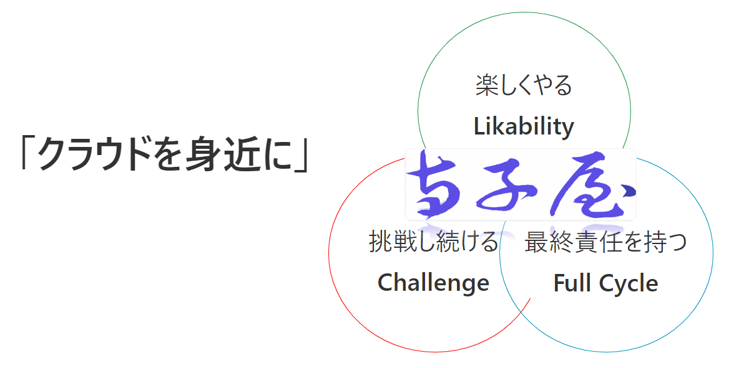
About Terrakoya Team
A team that started solving cloud-related issues with just 5 hours a week
Cloud technology closer to everyone
Notes:
The Terrakoya Team is part of the CCoE, the Cloud Center of Excellence, at DENSO.
Our team started as a side project with just five hours of activities each week.
Our mission is to bring cloud technology closer to everyone in the company.
We have three core values:
Likability, which means having fun while we work;
Challenge, which means we constantly strive to improve;
and
Full Cycle, which means we manage the entire process from planning to sales, development, and maintenance.
This way, we eliminate sectionalism and create valuable products.

Slide 7
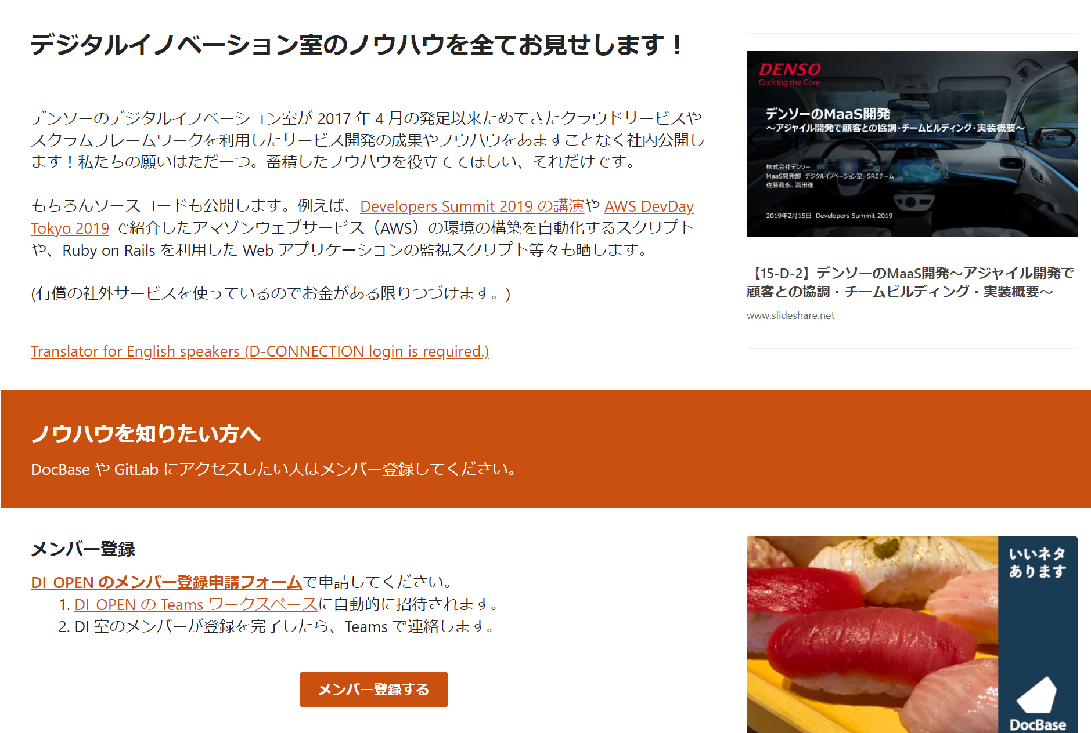
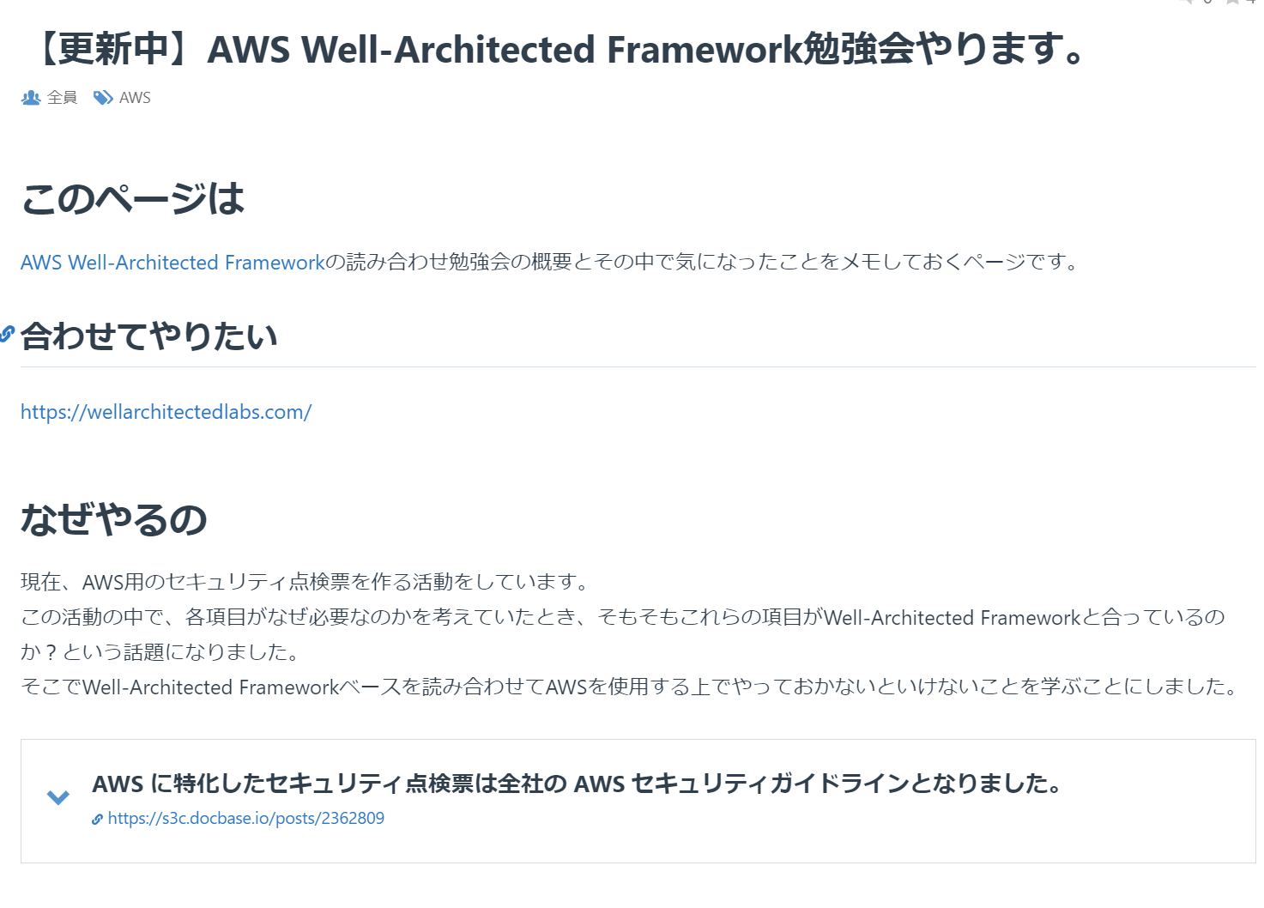
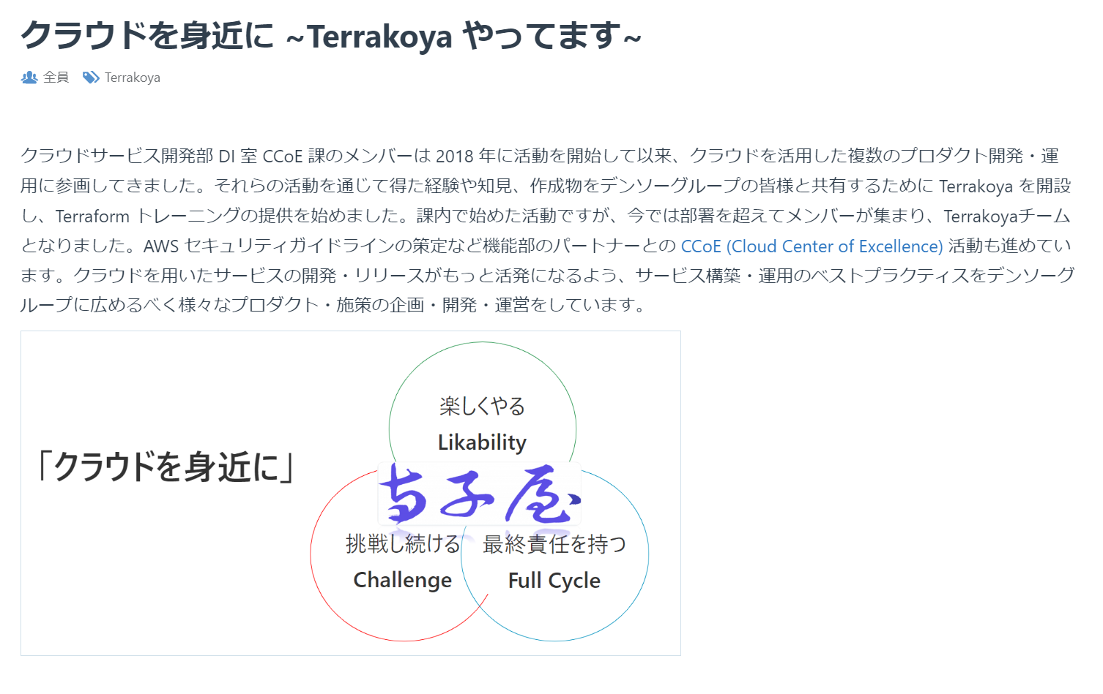
How the Terrakoya Team Was Formed
Actively promoted Terrakoya and AWS information internally
Hosted internships to provide opportunities to engage with Terrakoya activities
Motivated members with a keen interest in cloud technology gathered across departments
Notes:
How the Terrakoya team was formed.
First, we promoted information about Terrakoya and AWS inside our company.
This made people interested in our activities.
Second, we hosted internships.
This gave employees a chance to join and see our work.
Finally, we gathered motivated members from different departments who wanted to use cloud technology.
We did this because we needed members with strong motivation and awareness of cloud challenges.
Since this started as a side project, people needed to balance it with their main jobs. So, having a strong reason to join was important for success

Slide 8
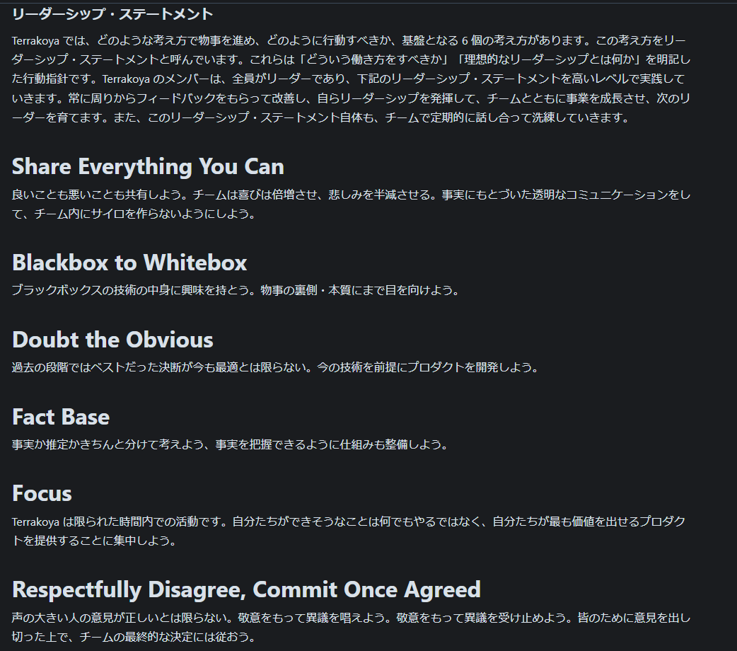
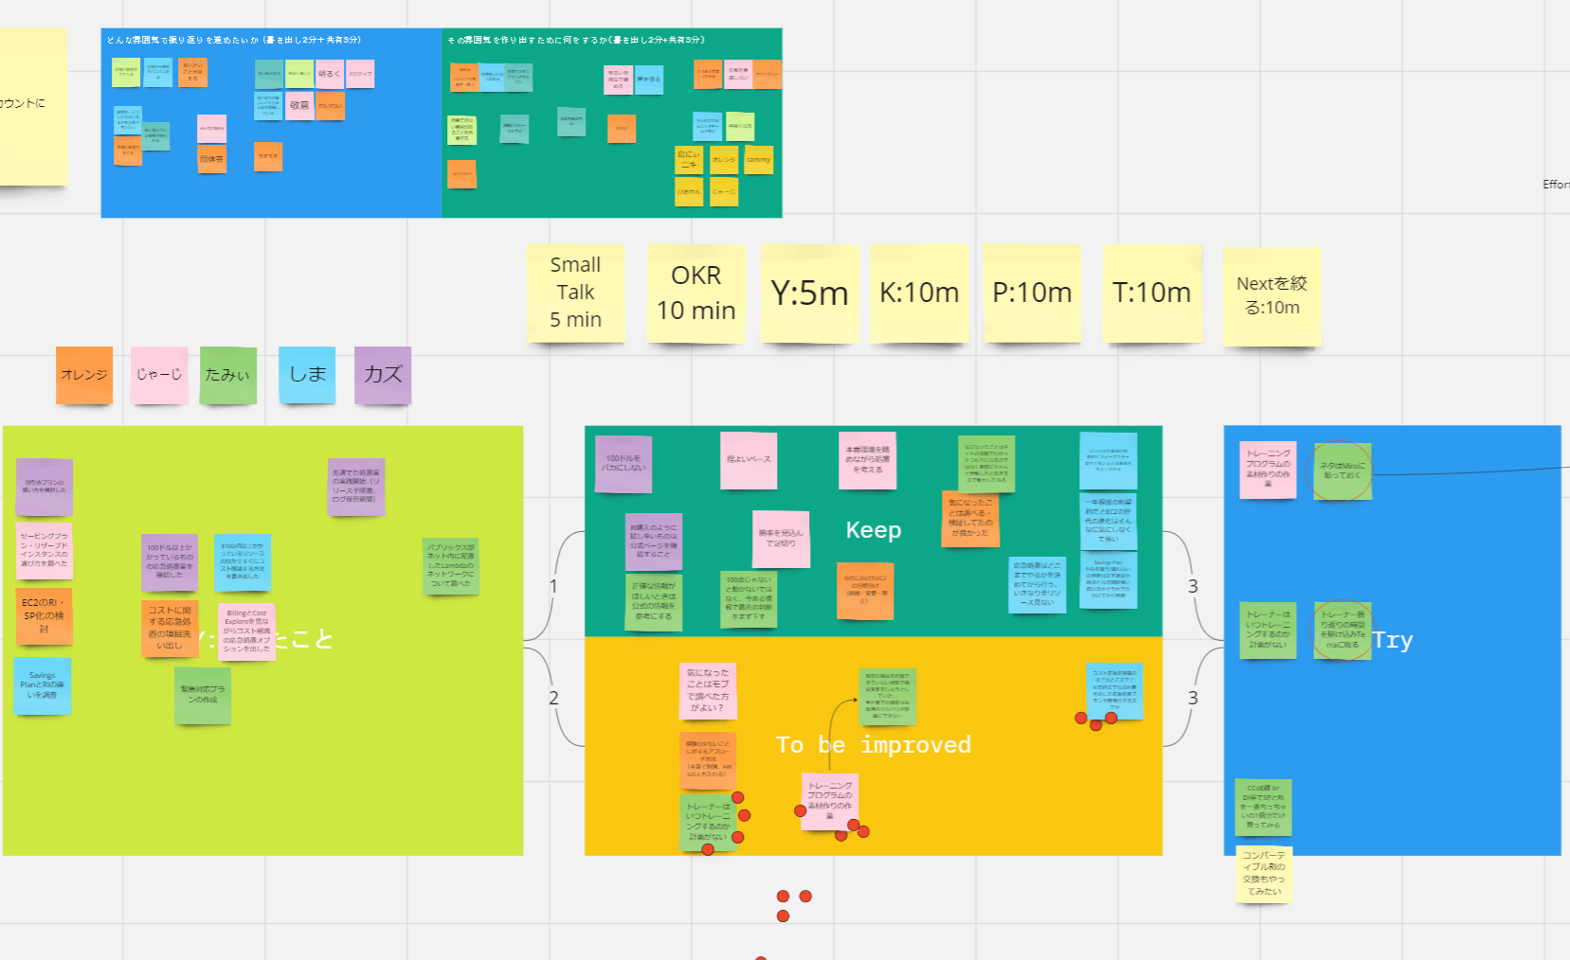
Team Management Strategies
Defined mission, values, and leadership statement
Use nicknames to avoid hierarchy
Adopted mob programming to synchronize all tasks
Notes:
Let's talk about our team management strategies.
First, we defined our mission, values, and leadership statement.
This helps everyone understand our goals and work together better.
Second, we use nicknames instead of titles.
This breaks down barriers and makes everyone feel equal.
It helps younger members speak up more.
Finally, we use mob programming.
The whole team works together on tasks.
This keeps everyone on the same page.
We also use different retrospective methods like KPT, Sailboat, and Fun Done Learn.
This keeps things interesting and helps us find new ways to improve.

Slide 9
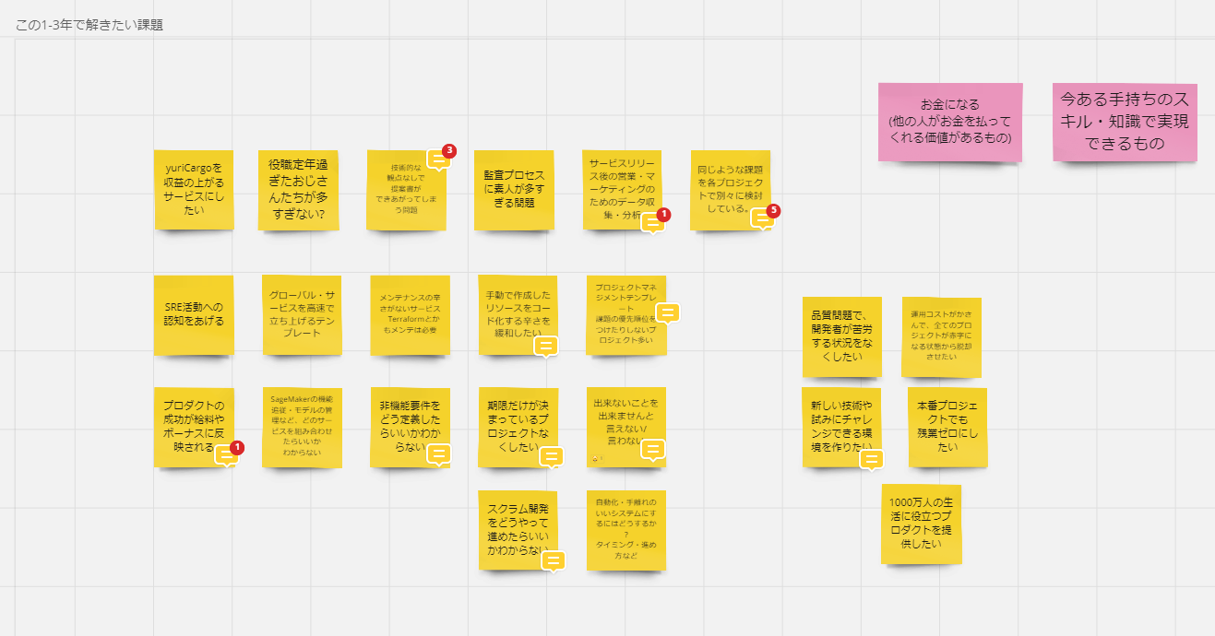
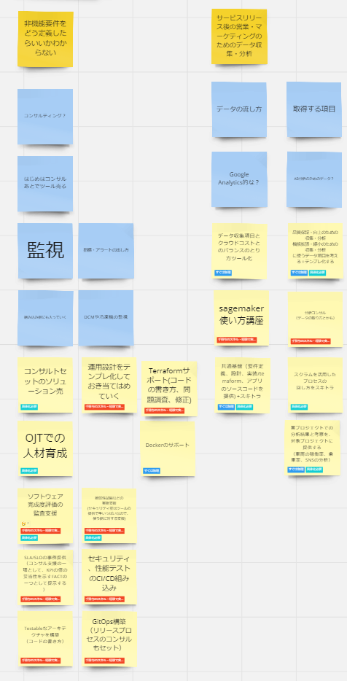
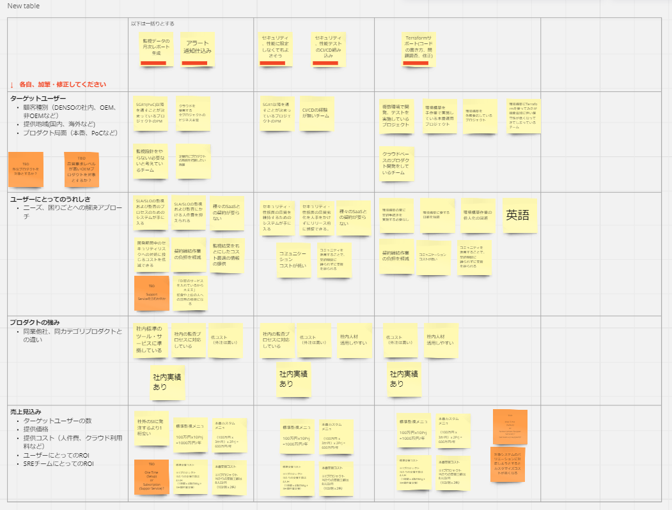
Product Concept
Decided what kind of product to make
Focus on skills we already have
Solve real, close-to-home problems
Address issues people will pay for
Identify problems to solve in the next 1-3 years
Notes:
Here’s the concept of our product.
This project started from a 1-on-1 conversation.
At first, it was just an idea.
But to make it real, we created an inception deck and discussed it with the whole team.
It was important to be clear about what we wanted to achieve and what our goals were.
First, we decided what kind of product to make.
Since this was a side project, we focused on skills we already have.
Second, we wanted to solve real problems that were close to us.
Finally, we aimed to address issues that people would be willing to pay for.
We also identified problems we wanted to solve in the next 1-3 years.
This helped us focus on what was most important and achievable.

Slide 10
Terrakoya's Released Products
Terraform Basic Training
Internal AWS Security Guidelines
Operational Muscle Training 👈 Today's focus
Training for IT service operations skills and knowledge
Terrakoya members act as trainers, solving real-world issues together
Examples: AWS cost optimization, release process optimization
Notes:
The products Terrakoya has released so far.
First, we have Terraform Basic Training. This training was adopted by the digital key operations team.
They needed Terraform skills to complete their project on time.
Our training helped them acquire these skills and finish on schedule.
Second, we created Internal AWS Security Guidelines.
Before this, we didn't have a defined security baseline for using AWS.
We used GitHub and Hugo to build this. With GitHub, we could openly discuss and track changes.
This guideline is now linked with our CSPM, which means we no longer need to submit individual security checklists for AWS projects.
This has made it much easier to start using AWS.
As we developed these products and listened to user feedback, we saw the need for ongoing improvement activities.
This led us to create Operational Muscle Training.
This training helps improve IT service operations skills and knowledge.
Examples include AWS cost optimization and release process optimization.
Today's presentation , we will focus on this Operational Muscle Training

Slide 11

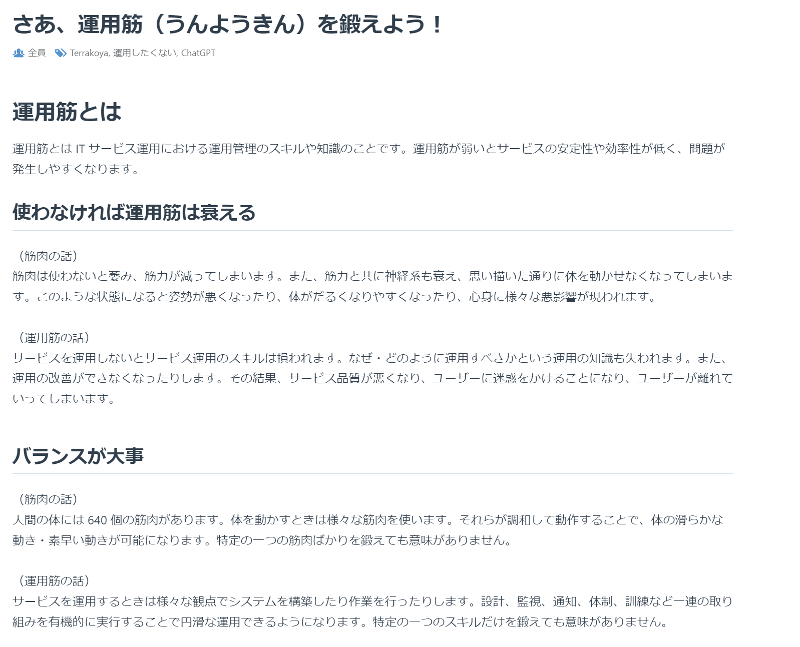
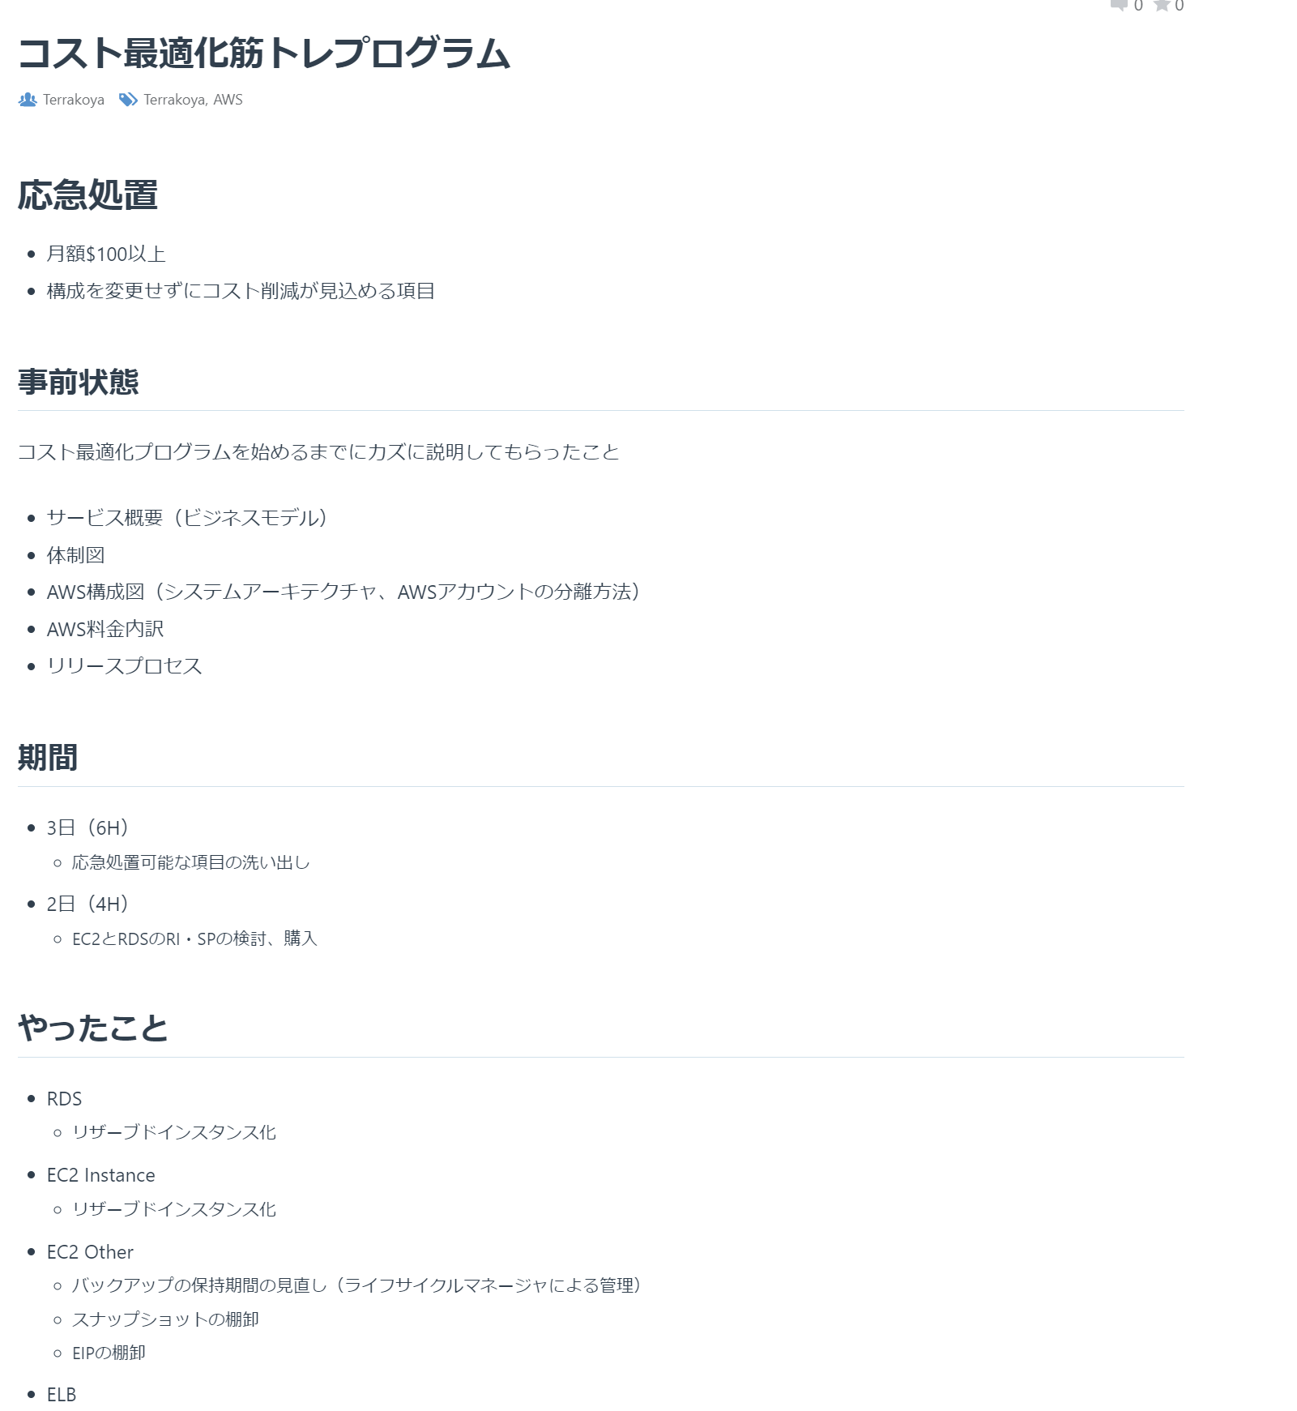
Train Operational Muscles
Continuous training for operational skills, like muscle training
Trainers create training plans based on team needs
Trainers and teams work together using mob programming to solve issues
Notes:
Let's talk about training operational muscles.
First, what do we mean by 'operational muscles'?
This is a term we created to describe the skills and knowledge needed for IT service operations.
Just like physical muscles, these skills need continuous training to stay strong.
To emphasize this, we developed the Operational Muscle Training Program.
In this program, Terrakoya team members act as trainers.
They listen to the needs of development and operations teams to create the best training plans.
Trainers then work with the teams using mob programming.
This means we do the training together, sharing knowledge and solving real issues.
This hands-on method helps teams improve their operational skills effectively.

Slide 12
Benefits of Training Operational Muscles
Operational muscles weaken if not used
Balance is important
Training reduces effort needed for operations
Training lowers the risk of service failures
Example: If we don't use a CI/CD pipeline and continue with manual releases, it creates problems. By building processes into our operations and regularly reviewing them, we can make operations smoother. We call this operational muscle training.
Notes:
The benefits of training operational muscles.
First, operational skills weaken if not used. If we don't use our body muscles, they become weak and we get tired easily. Bad posture and health problems follow.
Similarly, if we don't use our operational skills, we forget important knowledge and can't improve processes. Service quality drops, making users unhappy. They may leave.
Second, balance is important. The human body has about 640 muscles. We use many muscles together for smooth and quick movements. Training only one muscle is not effective.
In service operations, we need to consider design, monitoring, notifications, organization, and training. Doing all these well ensures smooth operations. Focusing on just one skill is not enough.
Third, training reduces effort. Training muscles lowers physical load, shortens work time, and reduces stress.
Similarly, training operational muscles makes work more efficient, shortens operational time, and reduces stress.
Finally, training reduces the risk of failures. Stronger muscles mean fewer injuries.
Similarly, better operational skills mean fewer service failures.
For example, if we don't use a CI/CD pipeline and continue with manual releases, it creates problems.
By building processes into our operations and regularly reviewing them, we can make operations smoother.
We call this operational muscle training. This regular training helps us maintain strong operational muscles and improve our overall performance.

Slide 13
Effects of Training Operational Muscles
Better "immune system" to handle customer complaints smoothly
Keep better records to talk with customers based on facts
Improve mental stability, sleep better at night
Create systems to avoid night-time emergency responses, making night on-calls unnecessary
Reduce internal and external pressure during incident recovery
Notes:
The effects of training operational muscles.
First, with a better 'immune system,' we can handle customer complaints more smoothly.
We keep better records, so we can talk with customers based on facts.
It improves our mental stability, allowing us to sleep better at night.
Next, we create systems that avoid night-time emergency responses, making night on-calls unnecessary.
It reduces the pressure from internal and external sources during incident recovery.
This way, we can focus on solving the issue without additional stress.

Slide 14
How to Train Operational Muscles
Learn the system, purpose, and methods
Exercise operational muscles daily
Adopt the latest practices
Get external trainers for guidance
Notes:
Here’s how to train operational muscles.
First, learn the system, purpose, and methods.
Random actions do not give good results. Understand how each movement affects muscles.
Know what nutrition and habits are needed for muscle growth and recovery.
In operations, understand the whole mechanism.
Learn the required skills and knowledge.
Use the right tools and practices to reduce manual work and improve operations.
Second, exercise operational muscles daily. Regular use keeps them strong.
Third, adopt the latest practices.
Training methods evolve. Learn and use the newest practices.
Finally, get external trainers for guidance.
Find trainers who can give the right guidance. Improve operational skills with their help.

Slide 15
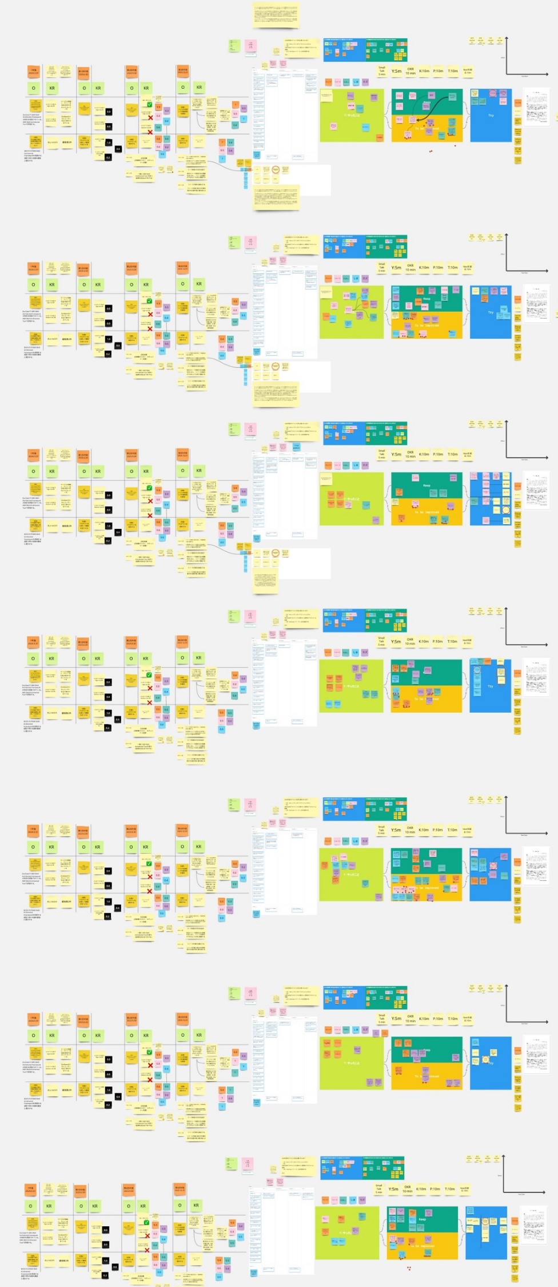
Operational Muscle Training Schedule
One-week sprint
Tuesday: 2 hours + Thursday: 2 hours + Friday: 1 hour retrospective
Review both the process and the training content
Notes:
Now, let's introduce how we conduct operational muscle training.
We use a one-week sprint format.
On Tuesday, we have 2 hours of training.
On Thursday, we have another 2 hours of training.
On Friday, we spend 1 hour on a retrospective.
We don't just review the process.
We also review the content of the training.
This helps us see what we did well and what we can improve.
This is how we ensure our training is effective and continuously improving

Slide 16
The First Step of Operational Muscle Training
Provided training to commercial product development teams
To begin with, we provided first aid improvements. Below are the results
Optimized release procedures:
  Reduced pre-release steps from 27 to 2
  Reduced backup steps from 7 to 1
  Eliminated post-release steps from 1 to 0
AWS Cost optimization:
  Trained teams on Reserved Instances and Savings Plans
  Achieved up to 60% reduction in server running costs
Notes:
Now, let's talk about the first step of our operational muscle training.
We provided training to commercial product development teams.
To begin with, we focused on first aid improvements.
Below are the results.
For release procedures, we optimized the process.
We reduced pre-release steps from 27 to 2, reduced backup steps from 7 to 1, and eliminated post-release steps from 1 to 0.
For AWS cost optimization, we trained teams on Reserved Instances and Savings Plans. This helped us achieve up to a 60% reduction in server running costs.
Why did we start with first aid improvements?
We had a three-month contract to start with, so we needed to show visible results quickly to gain trust.
Also, since the commercial service had been running for ten years, we saw many opportunities for improvement."

Slide 17
Concrete Steps for Optimized Release Procedures
Review actual release procedure documents with trainees
Key questions to ask trainees:
  Why does this procedure exist?
  How did this procedure come to be?
Encourage insights through questions, not just pointing out issues
Notes:
Now, let's talk about the concrete steps for optimized release procedures.
First, we review the actual release procedure documents with the trainees.
This helps them understand the current process in detail.
We ask key questions to the trainees, such as:
Why does this procedure exist?
How did this procedure come to be?
We don't just point out issues. Instead, we encourage insights through questions.
This helps trainees think critically and understand the reasons behind each step.

Slide 18
AWS Cost Optimization
Start with what can be done quickly without changing the structure
Focus on services with high billing amounts
Check invoices as a team (mob programming)
  Set a threshold for review (e.g., items costing over $100)
Avoid structural changes due to planned future changes
Notes:
Next, let's talk about AWS cost optimization and the quick fixes we implemented.
We began with actions that could be done quickly without changing the existing structure.
This approach allowed us to make immediate improvements.
Our first focus was on services with high billing amounts.
By targeting these areas, we were able to achieve significant cost reductions early on.
To ensure accuracy, we checked invoices as a team through mob programming.
This collaborative approach helped us identify and address issues more effectively.
We also set a review threshold, focusing on items that cost over $100.
This helped us concentrate our efforts on the most impactful areas.
Lastly, we avoided structural changes because we had planned future modifications.
This ensured that our efforts were both efficient and aligned with our long-term goals."

Slide 19

Effects of First Aid Training
Optimized release procedures:
Reduced release steps from 35 to 3
Shortened release time by about 3 hours
AWS costs Optimization:
Achieved annual cost savings of 3 million yen
First aid
Remove Muda
Deliver value
Notes:
Now, let's talk about the effects of our first aid training.
We were able to solve several project challenges.
First, we optimized the release procedures.
We reduced the number of release steps from 35 to 3.
This also shortened the release time by about 3 hours.
Second, we optimized AWS usage costs.
Our efforts resulted in annual cost savings of 3 million yen.
These improvements show the impact of our first aid training and how it can quickly deliver significant results.
Because of these achievements, we were able to secure a continued contract.
This allowed us to conduct further operational muscle training, leading to even more improvements."

Slide 20

Challenge for Further Improvement
A trainee talked us with a concern:
"We plan to renew the infrastructure in September 2024, but we lack manpower."
"We thought if we could reduce the effort required for releases, we could allocate that time to the infrastructure renewal."
We want to use the time saved by automation for the renewal!
We want to learn automation technologies and operations that can be used with the new infrastructure!
Trainee from the Infrastructure Renewal Team
Notes:
After our first aid training, we got a contract extension. We then thought about more improvements.
At this time, a trainee talked to us about a problem:
"We plan to renew the infrastructure in September 2024, but we do not have enough people."
"If we can reduce the effort for releases, we can use that time for the renewal."
The trainee discussed this problem with the renewal team.
The renewal team members said:
"We want to learn automation technologies and operations that can be used with the new infrastructure!"
"We want to use the time saved by automation for the renewal!"

Slide 21




Team Roles and Positions
Product Team
Local Government
Terrakoya team
Proposals,
Requirement Hearings
Manager
Provides Training
Partner
Participates as a Trainee
Sales team
Trainee
Task Requests
Notes:
This is our relationship diagram.
This product is provided to local governments in Japan, and the development was entrusted to partner companies.
DENSO's sales team interacts with local governments and partner companies.
In this operational muscle training, the Infrastructure Renewal Team and Terrakoya worked together as a team.

Slide 22
Looked at the Actual Work and Confirmed the Facts
First, we analyzed the release tickets and work logs to see how releases were actually done.
As a result, we found the following:
Development and releases were repeated on a monthly milestone basis.
There was a release process for each function of the local government, and they were done in parallel.
Development and testing were done separately, but the release and post-release checks were combined into one process.
Each release took 20 hours.
Release tasks were outsourced to partners, and DENSO always conducted checks after releases to the test, staging, and production environments.
Notes:
First, we looked at the actual work and confirmed the facts.
We started by analyzing the release tickets and work logs to understand how releases were actually done.
As a result, we found the following:
Development and releases were repeated on a monthly milestone basis.
There was a release process for each function of the local government, and they were done in parallel.
Development and testing were done separately, but the release and post-release checks were combined into one process.
Each release took 20 hours.
Release tasks were outsourced to partners, and DENSO always conducted checks after releases to the test, staging, and production environments.

Slide 23
Forming Hypotheses
Based on our analysis, we formed the following hypotheses:
Can we release some features to production without waiting for the monthly release?
Are we spending too much effort on post-release checks?
Are we outsourcing tasks to partners that DENSO could do internally?
Notes:
Based on our analysis, we formed the following hypotheses:
First, we might be able to release some features to production without waiting for the monthly release.
Second, we might be spending too much effort on post-release checks.
Third, we might be outsourcing tasks to partners that DENSO could do internally.

Slide 24
Forming Hypotheses and Validating with the Team
We shared our hypotheses with the sales team to verify the facts:
Some features can be released to production without waiting for the monthly release.
  It seems that 80% of releases are just Config (configuration file) changes.
Post-release checks take a lot of effort.
  There are duplicated checks between partners and DENSO.
We are asking partners to do tasks that DENSO could do.
  Communicating with partners and confirming tasks take extra effort, but it is hard to bring tasks back to DENSO with the current system.
  If DENSO can handle Config changes, it would have the biggest impact.
After talking, we realized:
If DENSO can handle Config changes releases by itself, it could bring significant improvements.
Notes:
We shared our hypotheses with the sales team to verify the facts:
First, some features can be released to production without waiting for the monthly release.
Second, it seems that 80% of releases are just Config changes.
Third, post-release checks take a lot of effort.
Fourth, there are duplicated checks between partners and DENSO.
Fifth, we are asking partners to do tasks that DENSO could do.
Sixth, communicating with partners and confirming tasks take extra effort, but it is hard to bring tasks back to DENSO with the current system.
Finally, if DENSO can handle Config changes, it would have the biggest impact.
After talking, we realized:
If DENSO can handle Config changes releases by itself, it could bring significant improvements.

Slide 25
Understanding the Config Change Release Flow in Detail
As a result, we found the following:
DENSO's sales team directly requested changes from the partners.
Multiple exchanges were required with partners to finalize the Config items.
Config was converted from Excel input values to PHP code using macros.
The Excel macros were not version-controlled, so DENSO did not know which macro was used for which customer.
After conversion to PHP code, further manual corrections were made. The release manual did not specify what to change.
To handle Config changes within DENSO, we needed to design the entire release flow, including the actions of the sales team.
Notes:
We needed to understand the Config change release flow in detail.
As a result, we found the following:
First, DENSO's sales team directly requested changes from the partners.
Second, multiple exchanges were required with partners to finalize the Config items.
Third, Config was converted from Excel input values to PHP code using macros.
Fourth, the Excel macros were not version-controlled, so DENSO did not know which macro was used for which customer.
Fifth, after conversion to PHP code, further manual corrections were made. The release manual did not specify what to change.
To handle Config changes within DENSO, we needed to design the entire release flow, including the actions of the sales team.
Additionally, we found:
There was a lot of manual work throughout the entire release flow.
Most of the tasks were done by partners.
There was a lot of communication between organizations, leading to longer lead times.
We were asking partners to do tasks that DENSO members could handle, which added extra effort.
There were many configuration files for each function of the local government, and each required its own changes.

Slide 26


Confirming the Config Change Release Flow
Product Team
How about this?
Local Government
We want to do this
the requirements
Partner
There are issues
fixed them
Sales Team
We made it, please check
Macro
OK, let's release it
Release done, please check
Release Manual
No issues
Notes:
This diagram shows the current Config change release flow.
We can see that there are multiple exchanges between our sales team and partners.
First, the local government communicates their needs to our service team.
Our sales team then conveys these requirements to the partners.
Partners make changes and ask for confirmation from our sales team.
Our sales team reviews and provides feedback, leading to more exchanges if there are any issues.
Finally, once everything is confirmed, the partners release the changes and our team does a final check.
This process involves a lot of back-and-forth communication, which slows down the release.
We realized that if DENSO can handle the Config changes internally, we could eliminate this communication steps with partners.
This would speed up the release process significantly.

Slide 27
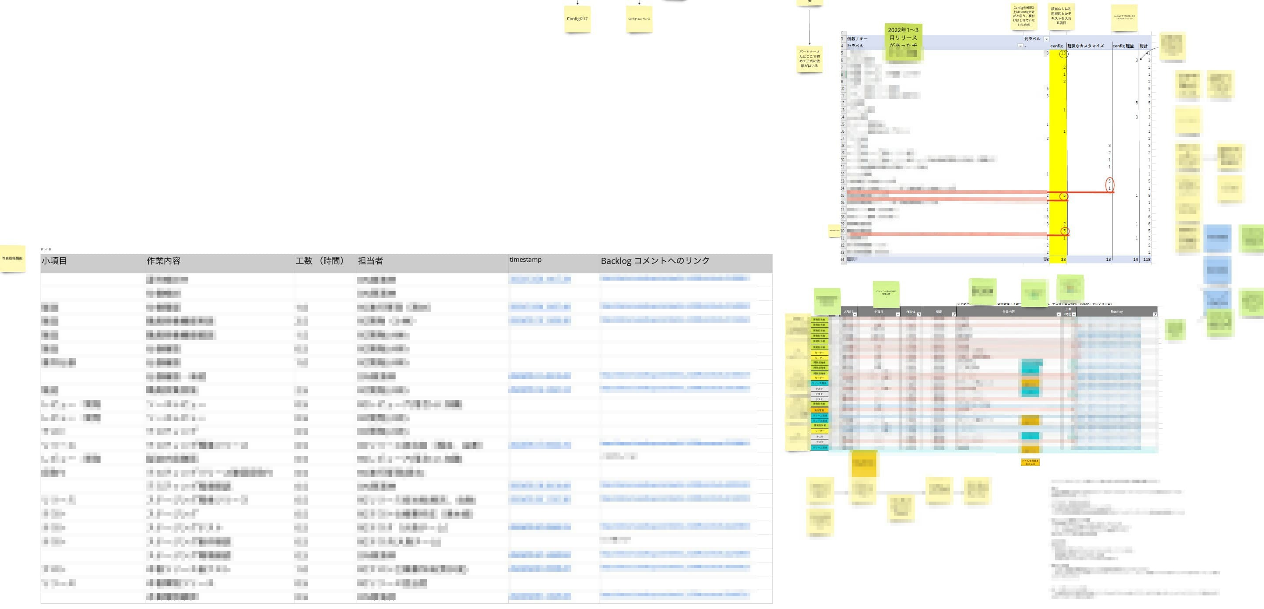
Choosing Functions to Automate
Automating all release flows is not practical.
Start with high-impact functions.
Analyzed last year's release data to find the best functions to automate.
Analyze release results to see who spent how much time on what and when.
Notes:
Automating all release flows is not practical.
The release process is a heavy burden.
The current system will end after the infrastructure renewal in September, so we need quick implementation.
We decided to start with high-impact functions.
We analyzed last year's release data to find the best functions to automate.
In the analysis, we looked at who spent how much time on what and when.

Slide 28
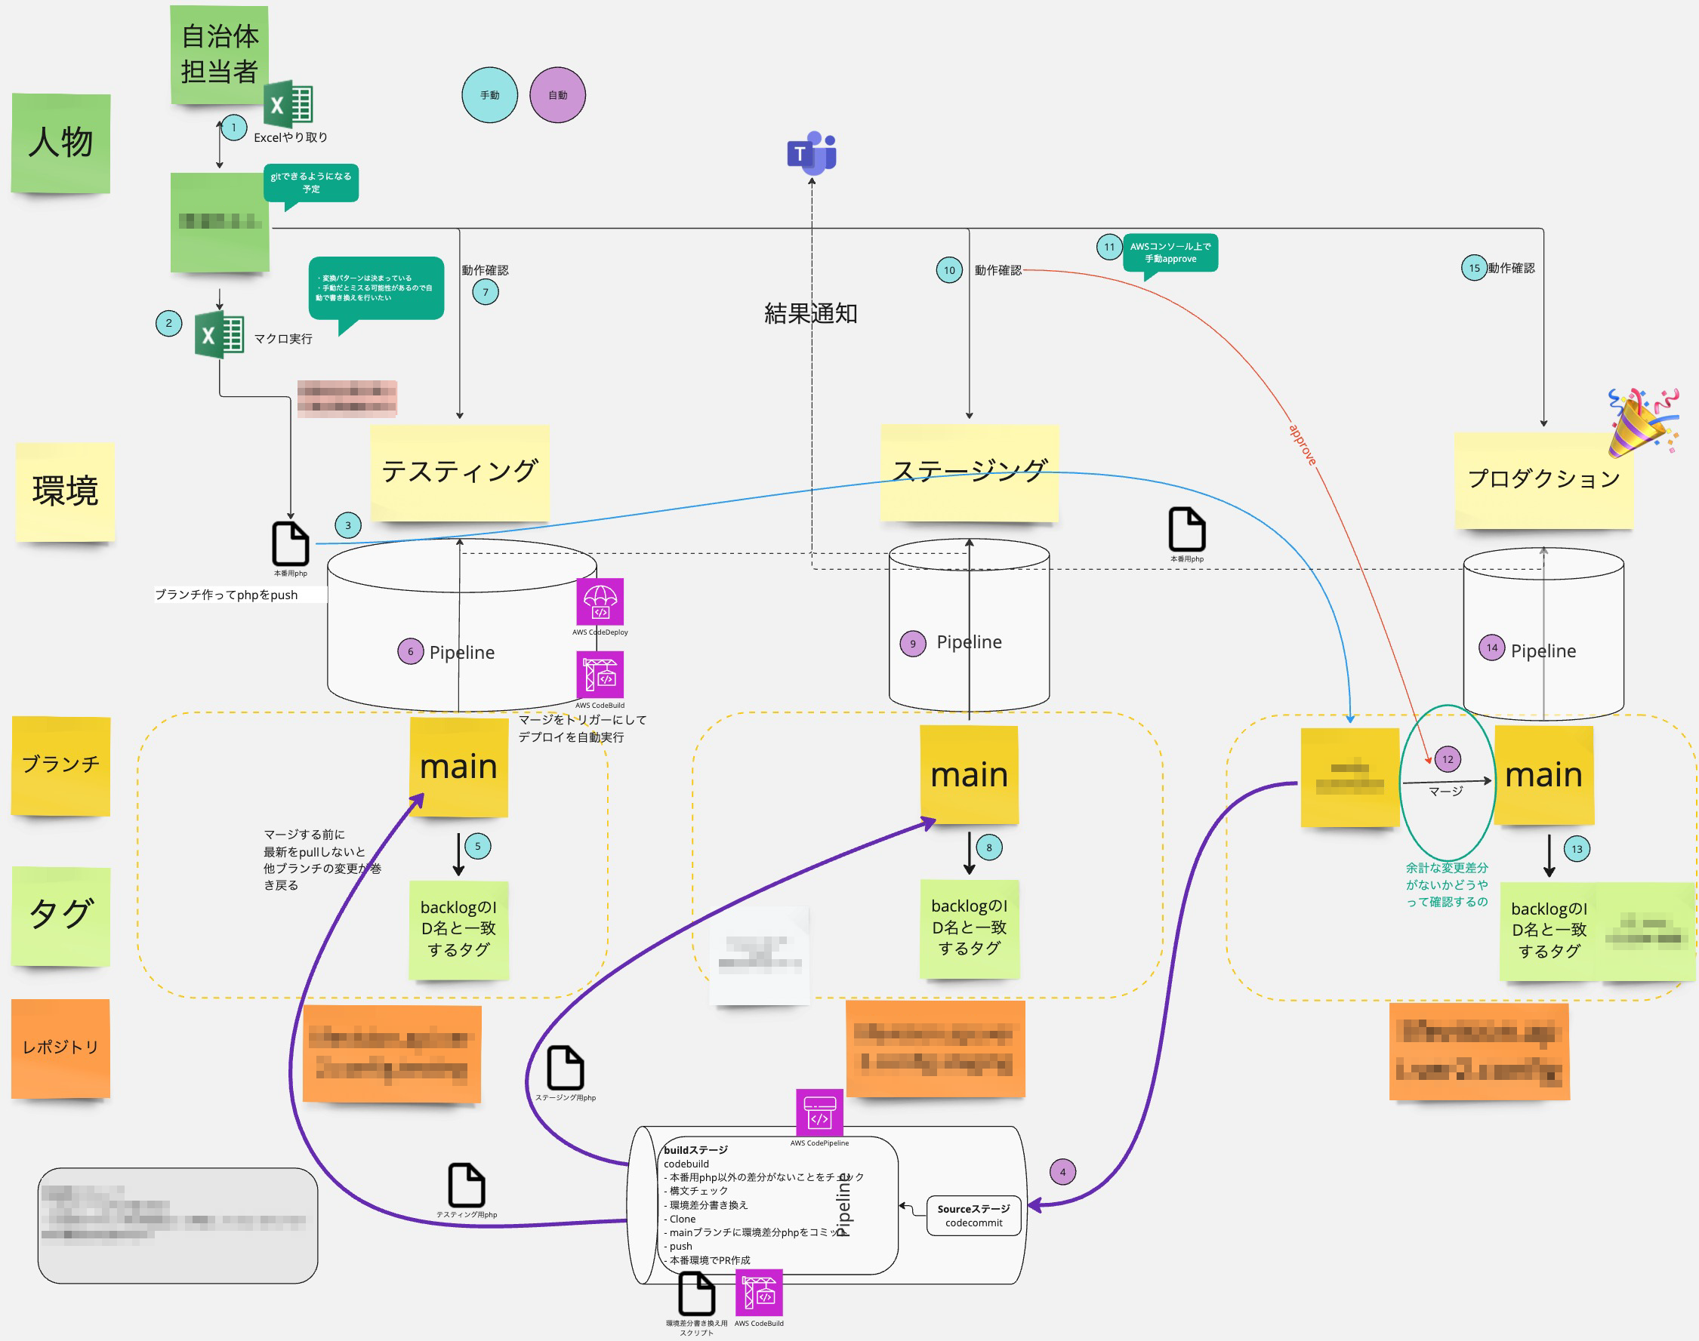
Building a Release Pipeline Based on Analysis
Identified technical challenges.
Created a test environment and iterated until the release pipeline worked smoothly.
Notes:
Based on our analysis, we built a release pipeline.
First, we identified technical challenges.
Next, we created a test environment and iterated until the release pipeline worked smoothly.
As you can see in this diagram, the repositories for testing, staging, and production are separate, and nearly the same code is pushed to each one.
We are experimenting with making the release pipeline work in this state.
Also, the process involves creating Configs using Excel macros, which are difficult to maintain.
Considering the difficulty of maintaining Excel macros, we are designing the pipeline to minimize impact and avoid major changes to the existing release system.

Slide 29
Taked to Sales Team again
We realized that technical feasibility is one thing, but whether non-engineer sales staff can execute the release process is another.
Especially, using Git to push Configs to the repository seemed challenging.
If it's difficult, we needed to make the process easier for them.
Therefore, we got feedback from sales team at the design stage of the pipeline.
Sales team responded, "We can do this."
Notes:
We realized that technical feasibility is one thing, but whether non-engineer sales staff can execute the release process is another.
Especially, using Git to push Configs to the repository seemed challenging.
If it's difficult, we needed to make the process easier for them.
Therefore, we got feedback from sales team at the design stage of the pipeline.
Sales team responded, "We can do this."

Slide 30
Taked to Sales Team again
We realized that technical feasibility is one thing, but whether non-engineer sales staff can execute the release process is another.
Especially, using Git to push Configs to the repository seemed challenging.
If it's difficult, we needed to make the process easier for them.
Therefore, we got feedback from sales team at the design stage of the pipeline.
Sales team responded, "We can do this."
Avoid implementing too many features at first
Talked to users about what they can accept
Notes:
It's important to avoid implementing too many features at first.
We talked to users about what they can accept.
The sales team were engineers before.
They could learn to use Git even though they had never used it before.
We realized we didn't need to build overly rich features.
Creating rich features takes a lot of development time.
By talking with actual users, we found that it's important not to over-engineer the solution.

Slide 31
Estimating the Outcome of Release Automation
Understood tasks for implementation; estimated outcome of automated release flow.
Estimated cost reduction if the release pipeline runs until September 2024.
Expressed cost reduction in time and money for non-engineers.
Proposed to sales and managers; received positive feedback.
Notes:
We understood what needs to be done for implementation, so we estimated the outcome of running the automated release flow.
We estimated the cost reduction if the release pipeline is operated until the current infrastructure ends in September 2024.
We expressed the cost reduction in terms of time and money to make it easy for non-engineers to understand.
We proposed this to sales and managers, and received positive feedback to proceed.
The estimated cost reduction was higher than expected, which excited both sales and managers.

Slide 32
Estimating the Outcome of Release Automation
Understood tasks for implementation; estimated outcome of automated release flow.
Estimated cost reduction if the release pipeline runs until September 2024.
Expressed cost reduction in time and money for non-engineers.
Proposed to sales and managers; received positive feedback.
Use common language to express outcomes
Notes:
Use common language to express outcomes is very important.
It's often said that engineers' contributions are hard to visualize.
However, when talking about money, even if the engineering details are complex, the message gets across.

Slide 33

Customer Feedback
Growth and Improvement:
We received comments from a third-party perspective about tasks we hadn't reviewed ourselves and risks we hadn't noticed. The training highlighted the team's weaknesses, and we understood the points that needed to be checked. Now, we can handle some tasks ourselves.
The training didn't stop with a one-time improvement; we understood the perspectives to check, so we can continuously handle things ourselves.
About Terrakoya Trainers:
The highly specialized trainers not only have knowledge of AWS best practices but also understand the system structure, operation mechanisms, and real issues at the site. They provided training suited to our needs, which gave us satisfaction and peace of mind. We felt we were growing, so we could approach the training positively.
Notes:
We received very positive feedback from our trainees.
They appreciated the growth and improvement they experienced.
They mentioned that the training helped them see tasks and risks they had missed before.
It showed them their weak points and helped them understand what to check.
Now, they can handle some tasks on their own and continue improving.
They also recognized the skills of the Terrakoya trainers.
The trainers knew a lot about AWS best practices and understood their systems and problems.
The training was tailored to their needs, making them feel satisfied and confident.
This positive feedback shows the effectiveness of our training program.

Slide 34
Key Takeaways
Important points for involving the business side:
Observe the actual work and understand the facts.
Form hypotheses about the problems and verify them by talking to the people involved.
Avoid implementing too many features at first; find out what users can accept.
Use common language to express outcomes.
Notes:
Here are the key takeaways for involving the business side:
First, observe the actual work and understand the facts. This helps to see what's really happening.
Next, form hypotheses about the problems and verify them by talking to the people involved. This ensures your assumptions are correct.
Also, avoid implementing too many features at first. Find out what users can accept to make the process smoother.
Finally, use common language to express outcomes. This helps everyone understand the benefits, even if they are not engineers.

Slide 36

We are hiring

