Slide 1
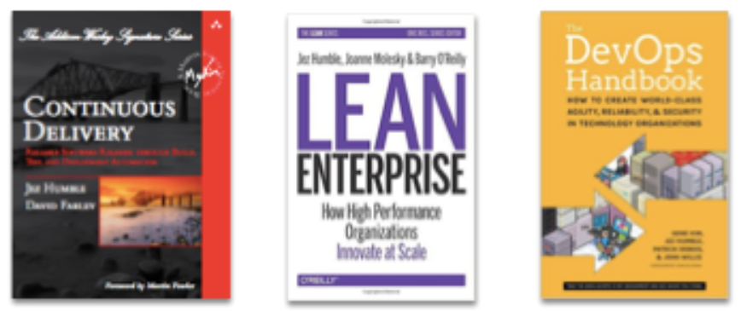
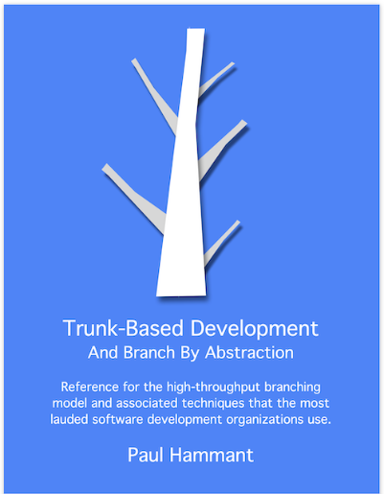
Trunk-Based Development makes DevOps easy
Paul Hammant @ DevOpsDays Taipei 2024
|——— Mentioned in these books —— | Wrote this one

Slide 2
Source-Control with DevOps is important to me
Teams should first explore Vendor infrastructure, mesh, cloud, monitoring, observability, analytics technologies by hand using their web-UIs and admin pages.
Then transition to scripts and config in source control (Git these days)
Even if the vendor’s technology has a good self-service UI, try to script the web-API instead.
If you make a self-service interface, encourage devs to script it.
Of course: No tokens in source control
For dev workstation setup Production environments Observation / analytics bits | Dev/test systems like CI/CD Pre-production environments Platform / mesh too
Notes:
3

Slide 3
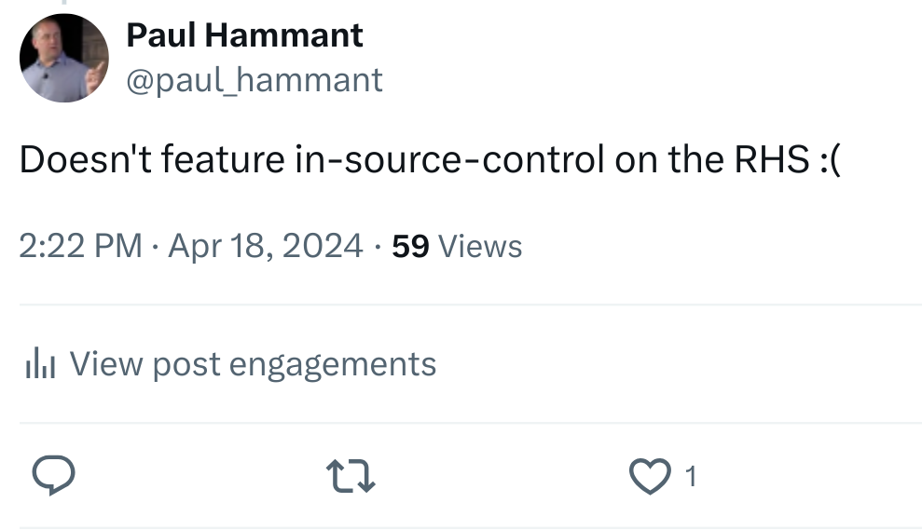

Pat Debois agrees
👇A reply to a tweet about DevOps 👇
It’s implicit in 1000’s of written articles, books, videos, but one Tweet (X) A “Like” calls it out:
“click”
Notes:
4

Slide 4
CI and Trunk-Based Development?
Continuous Integration (CI) needs Trunk-Based Development (TBD)
a “branching model” for source control
So says Martin Fowler and the other Agile Manifesto signatories … CI is an Agile practice
Other branching models are, therefore, un-Agile
Note: before Agile, you could have done Trunk-Based Development without other Agile other practices.
Notes:
7

Slide 5
Let’s talk about four different release cadences

Slide 6
Introducing Four companies ..
.. and four planned release cadences
Company 1/100
(Slow Enterprise)
One planned release every 100 days (or so)
(or quarterly)
Company 1/10
(Better Enterprise)
One planned release every 10 days (or so)
(or weekly)
Company 1/1
(Transitional)
One planned release every day
(or daily)
Company 10/1
(Fast DevOps/CD)
Ten planned releases every day
(or 10-a-day)
I blogged about this in 2014 and a 2015 book “Lean Enterprise” used my materials with permission
Notes:
10

Slide 7
4 companies: Un-planned releases per planned release
Company 1/100
(Slow Enterprise)
2.5 unplanned releases per planned release
Company 1/10
(Better Enterprise)
0.5 unplanned releases per planned release
Company 1/1
(Transitional)
< 0.1 unplanned releases per planned release
Company 10/1
(Fast DevOps/CD)
No unplanned releases per planned release
Notes:
13

Slide 8
Drama, hours, weekends, heroism
Practice…
1/100 Slow Enterprise
Lots of release drama and extra hours or weekends
1/10 Better Enterprise
Mild release drama, some extra hours
Blue/Green?
1/1 Transitional
Occasional extra hours
Canary?
10/1 Fast DevOps & CD
9 am to 5 pm weekdays only, no drama
No observable gate
“Amateurs practice until they get it right, but professionals practice
until they do not get it wrong” (as repeatedly told to musicians in training)
Lots forgotten
Mgmt: “More careful pls, go slower maybe?”
Practice frequent enough to change team capability
Practice paying off - everyone agrees.
Practice has eliminated errors
Notes:
17

Slide 9
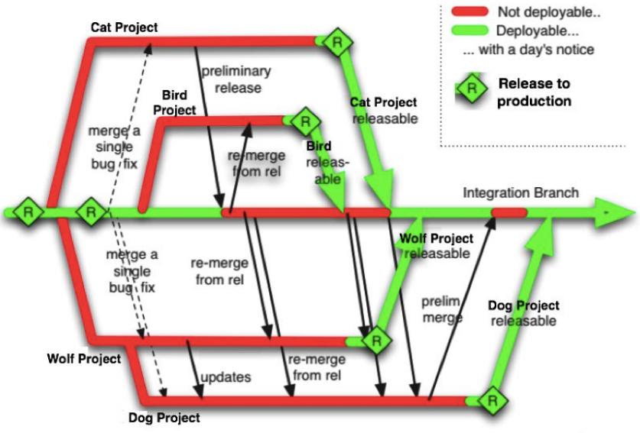
Bad Branching
models
1/100 Slow Enterprise
Merge close to release date is the intention
Merge pain !!
“Unmerge” is a problematic thing, late in development
https://paulhammant.com/blog/branch_by_abstraction.html (2007) - also used in CD book (2010)
Notes:
20

Slide 10
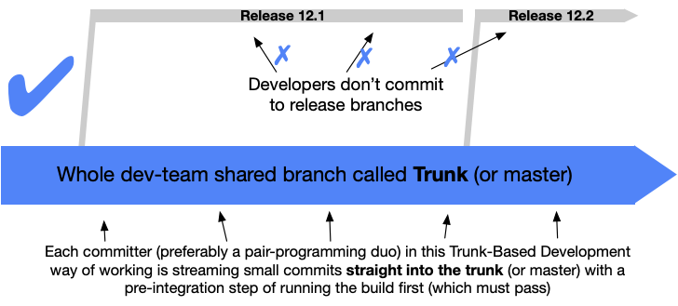
Traditional Trunk-Based
Development
One week duration
1/10 Better Enterprise
Nobody commits & pushes to trunk (or main) if it breaks the build
Feature flags or Toggles prevent the unmerge scenario
or 2024_27
or 2024_28
From TrunkBasedDevelopment.com (2017)
Notes:
23

Slide 11
Better TBD
One day duration
1/1 Transitional
Same “nobody breaks the build”
Flag/Toggles again
“Branch by Abstraction” for longer to achieve change
Release 2024_189
Rel 2024_189
GitHub-style “Pull Requests” much more likely
Notes:
26

Slide 12
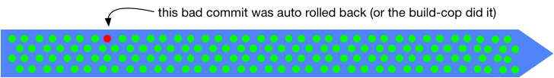
Google-class
TBD
One day duration
10/1 Fast DevOps & CD
Nobody breaks the build
Flag/Toggles
Branch by Abstraction
No release branches - only tags
Release 23362
Release 23364
Release 23366
Release 23368
Release 23370
Release 23373
Release 23361
Release 23363
Release 23365
Release 23367
Release 23369
Release 23372
GitHub-style “Pull Requests” or a patch queue
Notes:
29

Slide 13
Case Study - Big FX bank
180 people in the IT group
12 delivery teams
Bad branching model in terrible legacy
VCS technology
Lots of release drama, and lateness
I led them to:
Trunk Based Development in new (faster VCS technology)
Uniform build technology
Test automation for the first time.
One team at a time, we took six weeks to migrate all teams
We delivered all the functional commitments and this non-functional devops-ish change and went live two weeks early.
Notes:
31

Slide 14
More differentiators: pre-prod environments (QA, UAT, etc)
1/100 Slow Enterprise
Hand-built ages ago. Know-how stored in people’s heads (not source control, nor paper)
“No we can’t make a QA2”
1/10 Better Enterprise
Some scripts in trunk
QA rebuilt from time to time
Possible dependence of CI on shared QA env
“Give us a couple of days to make QA2”
1/1 Transitional
IaC definitions & templates in trunk - and real usages, too.
Test usages too (CI)
QA rebuilt regularly
“QA2 should take an hour. Do you have cloud $$$”
10/1 Fast DevOps & CD
All in trunk
CI is making ephemeral QA-like envs many times an hour
“QA env? Why do you need something that’s 10 mins ahead of production?”
Notes:
34

Slide 15
More differentiators: release binaries
1/100 Slow Enterprise
Chaos
1/10 Better Enterprise
Named for the release branch
“Shopping_cart_2024_27.pkg”
Used in roll-back releases
1/1 Transitional
Named for the release branch
“Shopping_cart_2024_189.pkg”
Used in rare roll-back releases
10/1 Fast DevOps & CD
Maybe not
“Fix forward” strategy means there’s no rollback releases
Notes:
39

Slide 16
More differentiators: databases
1/100 Slow Enterprise
Reliance of a DBA for table-shape changes, and changes in the release … all outside source control
1/10 Better Enterprise
Likely a Rel_12.1_to_12.2.sql script is in the trunk
On a just in time basis, also in the release branch
1/1 Transitional
Formal DB migration scripts
One per DB change
Also a hopefully unnecessary (but practiced) one that reverses the same change
10/1 Fast DevOps & CD
Same migration scripts idea but more methodical:
1234_add_str_haircolor.sql
1235_rmv_int_harocolor.sql
No script that would reverse the same.
Notes:
42

Slide 17
Google’s TBD monorepo
There is a range of release cadences for applications and services at Google.
App/service dependencies are upgraded in lockstep across the monorepo.
Deps are in the monorepo (binaries: third party, and source-deps: in house modules)
But…
Upgraded deps impacting many apps & services doesn’t mean lockstep releases for all
They have therefore retained release independence for biz app/service teams. Bazel (Blaze) facilitates this and some checkout tricks.
DevOps made “platform”
Infra / SRE / DevOps bits and pieces are also in the monorepo, but a little separated
Notes:
45

Slide 18
Two CD or not CD
(apologies to Shakespeare the playwright “To be or not to be”)

Slide 19
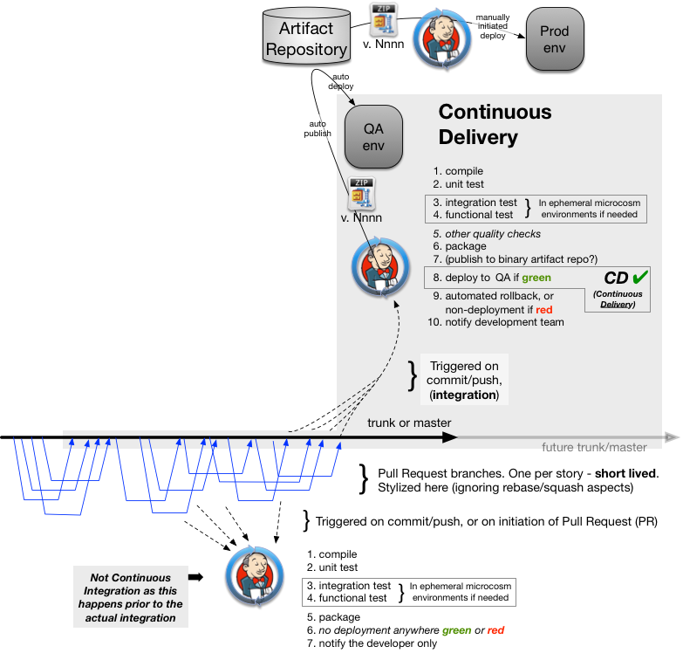
One CD: Continuous Delivery
Without a human saying “do the the release to QA” pull-requests integrated into trunk make it into QA (or UAT) …
… The CI build will have a pipeline that compiles, runs unit tests, runs component tests, perhaps brings up an ephemeral env to run full stack tests with some UI-clicking test runner …
… then deploys to QA (or UAT)
Humans choose when to go from
QA/UAT to prod.
See https://paulhammant.com/2018/05/23/examining-ci-cd-and-branching-models/
Notes:
48

Slide 20
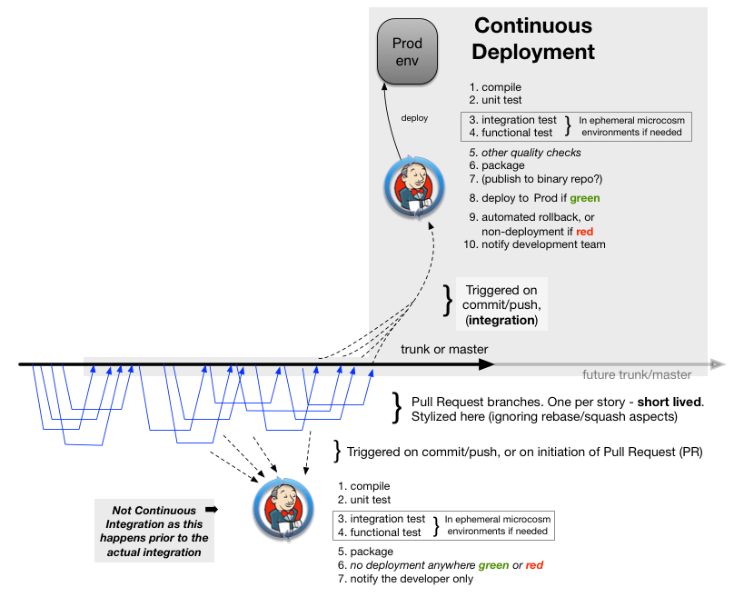
The other CD: Continuous Deployment
Without a human saying “do the the release to prod” pull-requests integrated into trunk make it all the way into production …
… The CI build will have a pipeline that compiles, runs unit tests, runs component tests, perhaps brings up an ephemeral env to run full stack tests with some UI-clicking test runner …
… then deploys to prod
See https://paulhammant.com/2018/05/23/examining-ci-cd-and-branching-models/
Notes:
51

Slide 21
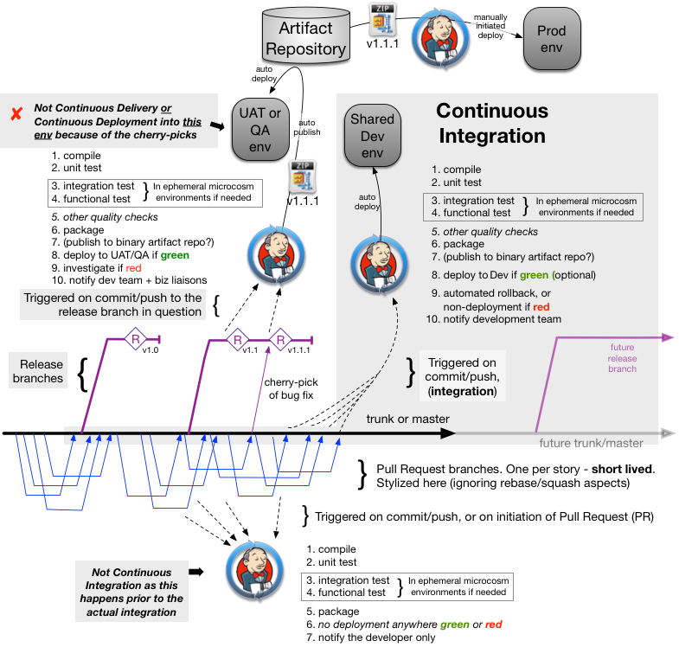
Non Continuous Delivery
Continuous Integration verifies work in source control and deploy to a “dev” or “integration” environment where no QA or UAT take place
Deploys to QA: Only on release branch creation does, and cherry picks to it does the QA or UAT environment get auto-deployed to and the end of a another CI-like job.
Notes:
54

Slide 22
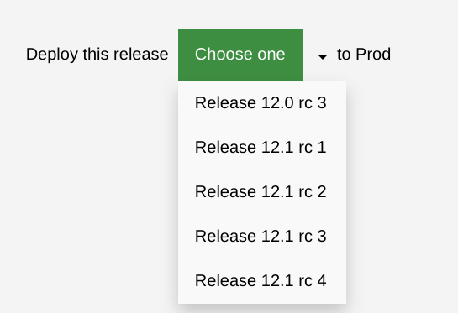
Continuous Delivery and Non Continuous Delivery
Most likely there’s a job/action that’s kicked off from a web page. Authorized people could pick a release:
Notes:
58

Slide 23
Grading companies/clients

Slide 24
At the get-to-know-you stage
How many planned production releases a year versus unplanned
For the same application/service
How long did it take you to make the QA (or UAT) environment?
How long would it take you to make a second QA-class environment that:
  Shared no services or databases with the first QA env
  Was firewall separated, or as good as.
  Could have separate per day usage costs made clear
After completing that QA2, how long would it take you to build a QA3 (same rules)?

Slide 25
Thank you.
Trunk Correlated Practices Chart (long PDF)
https://phdo.paulhammant.com/Trunk-Correlated-Practices-Chart
Trunk-Based Development Case study
(Dev rather than DevOps centric)
https://phdo.paulhammant.com/BofA-Platform-Case-Study
My Blog
https://paulhammant.com
My Email
paul@hammant.org

